Slide 1
Fake Currency Identification (An Application to detect counterfeit currency)
GUIDE NAME:
Mr. V.VINOTH KUMAR, B.E., M.E.
ASSISTANT PROFESSOR/CSE/MNMJEC
DONE BY:
SRIRAM KARTHICK K - 311619104073
VARUN KUMAR - 311619104079
IV year CSE/MNMJEC

Slide 2
Base Paper Details
Aman Bhatia, Vansh Kedia, Anshul Shroff, Mayand Kumar, Bickey Kumar Shah, Aryan ,
“Fake Currency Detection with Machine Learning
Algorithm and Image Processing”, DOI:10.1109/ICICCS51141.2021.9432274

Slide 3
Abstract
The one important asset of our country is Bank currency and to create discrepancies of money miscreants introduce the fake notes which resembles to original note in the financial market. During demonetization time it is seen that so much of fake currency is floating in market.
In this project, We are building an application for detecting the fake currency. Using this application we can easily find the difference between Fake Currency and Genuine Currency.
We are making use of KNN and SVC machine learning algorithm to differentiate the currency. KNN has a high accuracy for small data sets making it desirable to be used for the computer vision task. While SVC algorithm is effective for the tasks like image recognition, text classification and bioinformatics.
We are using these two algorithms in our application to produce the result with more accurate with the help of less dataset and in efficient manner.

Slide 4
Existing System
In the existing system, different traditional strategies and methods are available for fake currency identification based on the colors, width, and serial numbers mentioned.
Processing these attributes by using digital technologies will give high false positive results leading to lower accuracy of the technology.
In this system First, to classify the nationality to use certain predefined rules. Areas of significance, and then derive the denomination value.
Using features such as scale, color, or script on a note, based on how distinctive the notes are in the same region.

Slide 5
Proposed System
Our proposed solution/system is to use K-Nearest Neighbors and Support Vector Classifier.
KNN has a high accuracy for data sets making it desirable to be used for the computer vision task.
While SVC algorithm is effective for the tasks like image recognition, text classification and bioinformatics.
K- Nearest Neighbor and Support Vector Classifier is trained considering three train test ratio 80:20, 70:30 and 60:40 and measured their performance on the basis various quantitative analysis parameter like Precision, Accuracy, Recall, MCC, F1-Score and others.
And some of Supervised Machine Learning (SML) algorithm are giving nearly 98% accuracy for this particular train test ratio.

Slide 6
Literature Review
In [1], In the past studies the data collected for the fake note detection was with professional cameras but in those data, accuracy seen was to be fair and good due to simple machine learning algorithms. K nearest neighbor algorithms were used traditionally for the detection of fake notes. Systems were getting slower when the data size became large. After that system came across to classify the precision and recognition rate with some enhancement in Machine learning algorithms and deep learning concepts
In [2], Due to high and large data sets, data sets were getting distorted, and the precision was not effective a lot though it was 98%. All of these detections were carried out earlier only with open cv and python but time and again with modern deep learning techniques data were collected with the count of 100 images per denomination and then measured.

Slide 7
In [3], In 2021 the fake note is being detected with the algorithms of efficient Machine learning, Deep convolutional neural network, and followed by image processing. It has shown the efficiency to be maximum in today's days.
In [4], Accuracy of training and testing sets were measured. This brings the chain type efficiency that elongates to a larger value in comparison to other techniques. Concept of the transfer learning was used in the system. The noise was also captured, and this was another problem due to which much more advancement was required. After that, a Convolutional neural network came into the measurement for the error elimination. Loss trends were generally analyzed concerning training loss (TL) and validation loss (VL). Accuracy trends were generally analyzed by training accuracy (TA).

Slide 8
INTRODUCTION
In this century where the majority of people are aware of technology and how it works, many of them indulge in unlawful activities. One of such activities is the production of fake currency which is practiced to deceive people. In this proposal, it is focused on this illegitimate practice and try to bring forward a solution for it. According to a survey, the maximum number of cases of counterfeit in India still relate to fake currency, There were 132 cases of counterfeit currency in 2018, which shot up 37 percent to 181 in 2019.
In order to stop this fraudulent activity, a system is proposed that can be integrated into mobile devices that will detect the fake note as soon as it is scanned by the device. KNN and SVC is a SML algorithm which will be utilized in the proposed system with enhanced accuracy. K-nearest neighbors (KNN) is an algorithm that stores all the available data and classifies a new data point based on the similarity. SVC is effective in high-dimensional spaces.

Slide 9
Supervised machine learning techniques such as KNN and SVC were implemented. The dataset used to train these algorithms was collected by extracting features from banknote images. The dataset also classifies all the samples into a particular class i.e. genuine or forged. The dataset is cleaned and normalized to make the dataset not to be biased.
The model is created using the dataset which is cleaned and normalized. The model is then trained and tested until the accuracy is stable.
Finally the model is integrated with the application using api which will be build using the frameworks mentioned below.

Slide 10
Hardware Requirements
8GB RAM
AMD 3600 processor or an equivalent Intel processor
2GB storage capacity

Slide 11
Software Requirements
Python
Jupyter notebook
Visual Studio Code
Nodejs

Slide 12
System Architecture
Frontend
Camera
Data Set
Model Building
Integrate the model with framework
Dataset Pre processing
K-Nearest-Neighbor
And
Support Vector Classifier
Web Communication
Deploy

Slide 13
Modules
Data Collection :
This is the first step for creating an unbiased model. The quality of the dataset is as important as the quantity of the dataset, as bias can be induced easily. The crucial part of data collection is feature selection, involves choosing the most relevant features from the preprocessed data. This is important because using irrelevant or redundant features can negatively impact the performance of the machine learning models. Techniques such as correlation analysis, mutual information, and recursive feature elimination can be used for feature selection.
Data Pre-processing :
This involves cleaning, normalizing, and transforming the raw data to make it suitable for analysis. The main techniques used in data preprocessing are data cleaning, data transformation, and feature engineering. This step helps to improve the accuracy of the model which we are training. This process is done in order to remove redundancy and in appropriate data.

Slide 14
Model Building :
In this module the main part is choosing the appropriate algorithm for finding the fake currency from the properties of the image which is given. For our project we have concluded to use K-Nearest Neighbor algorithm to detect the fake currency, as KNN algorithm keep adding new data to the dataset, the prediction is adjusted without having to retrain a new model. So It is easy to keep the model upto date.
Training and Testing :
This process involves many iteration of model training with the data which we have cleaned in the previous steps until the model stabilizes and produces accurate results. Testing is the process of evaluating these results to obtain a unbiased model. If the model is biased the data set should be normalized properly.

Slide 15
App building :
In this step the model which we have built is integrated with the mobile application with the help of Application programmable interface, and the application is tested for any errors which may occur due to communication failure.
Deploy the app :
This is the final step which is to deploy the application in the web.

Slide 16
Modules | Functional Requirement | Task | Start Date
Module 1 | Data collection (Currency Notes) | Collecting raw images of currency notes | 17/02/2023
Module 2 | Data Pre -processing | Scaling the data for effective utilization | 24/02/2023
Module 3 | Model building | Choosing the best model for better accuracy | 03/03/2023
Module 4 | Training & Testing | Model will be trained and tested numerous times | 17/03/2023
Module 5 | App building | Integrating the model with the mobile application | 24/03/2023
Module 6 | Deploy the app | Making the model available to the users through a application | 31/03/2023

Slide 17
Percentage of work completed
We have completed about 25% of work till now. Which includes the processes mentioned below,
finding dataset
Analysis the dataset
Cleaning the dataset
Normalizing the dataset based on the formula
Currently testing the dataset on KNN-Model and Support Vector Classifier (SVC) model

Slide 18
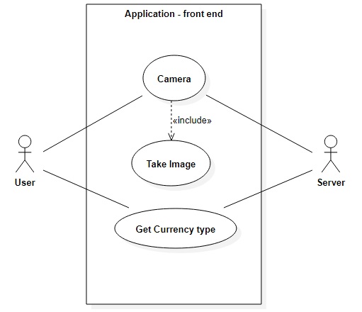
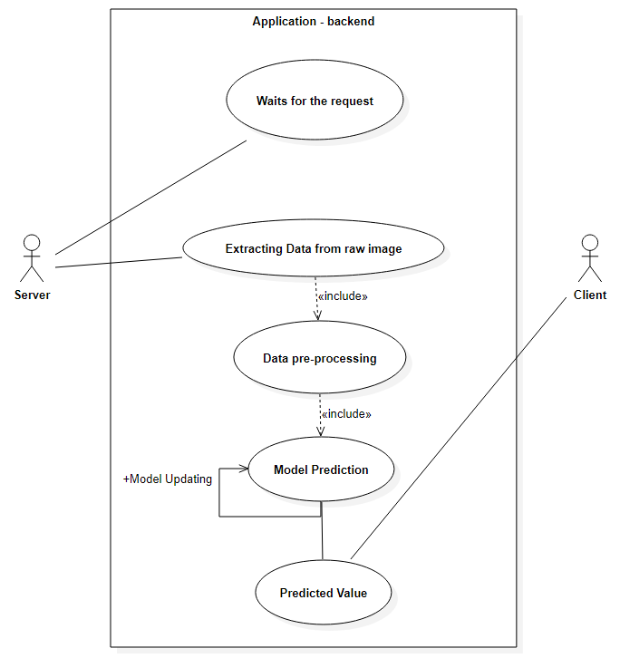
Use case Diagram

Slide 19
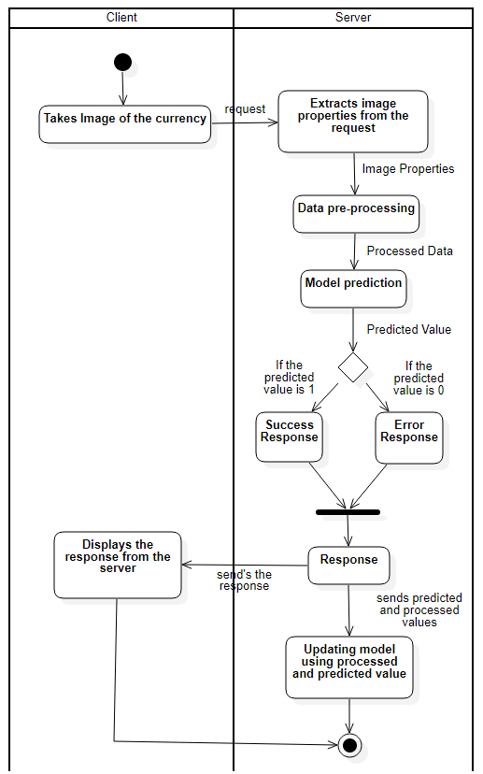
Activity Diagram

Slide 20
Coding
import matplotlib.pyplot as plt
import seaborn as sns
import numpy as np
import pandas as pd
df=pd.read_csv('BankNote_Authentication.csv')
df.head()
df.shape
df.describe()
df.isnull().sum()
df.isna().sum()
df.columns
df.describe().T
df.info()

Slide 21
target = 'class'
ax = sns.countplot(x = target, data = df)
print(df[target].value_counts())
sns.heatmap(df.corr(),annot = True,cmap = 'mako',cbar = True,linewidths = 0.2)
fig = plt.gcf()
plt.show()
sns.pairplot(df,hue ="class")
sns.displot(df["variance"], height = 4, aspect = 1.5)
plt.xlabel("Variance")
sns.displot(df["curtosis"], height = 4, aspect = 1.5)
plt.xlabel("Curtosis")
sns.displot(df["skewness"], height = 4, aspect = 1.75)
plt.xlabel("Skewness")
sns.displot(df["entropy"], height = 4, aspect = 1.75)
plt.xlabel("Entropy")
sns.histplot(data=df)
sns.jointplot(data=df, x="variance", y="class")
sns.jointplot(data=df,x='curtosis',y='class')
sns.jointplot(data=df,x='entropy',y='class')

Slide 22
x=df.drop('class',axis=1)
y=df['class']
from sklearn.model_selection import train_test_split
x_train, x_test, y_train, y_test = train_test_split(x, y, test_size = .20, random_state = 1)
#LINEAR SUPPORT VECTOR CLASSIFIER
from sklearn.svm import SVC
## Instantiate the model
svc = SVC()
# Fit the model on training data
svc.fit(x_train, y_train)
## Getting the predictions for x_test
y_pred_svc = svc.predict(x_test)
print('--'*50)
svc_accuracy = round(accuracy_score(y_test, y_pred_svc)*100,8)
print('Accuracy = ', svc_accuracy,'%')

Slide 23
#KNN
from sklearn.neighbors import KNeighborsClassifier
from sklearn.model_selection import KFold,GridSearchCV
param_grid={'leaf_size':[2,5,7,9,11],'n_neighbors':[2,5,7,9,11],'p':[1,2]}
grid=GridSearchCV(KNeighborsClassifier(),param_grid=param_grid)
grid.fit(x_train,y_train)
KNN=KNeighborsClassifier(n_neighbors=11,p=2,leaf_size=5)
KNN.fit(x_train,y_train)
KNN_pred=KNN.predict(x_test)
KNN_pred
knn_accuracy = round(accuracy_score(y_test, KNN_pred)*100,8)
print('Accuracy = ',knn_accuracy,'%')

Slide 24
Deviation
We have included an extra algorithm in this project which is SVC for more efficient result.

Slide 25
Paper References
D. V. Kapare, S. Lokhande, and S. Kale, “Automatic Cash Deposite Machine With Currency Detection Using Fluorescent And UV Light,” vol. 3, pp. 309–311, 2020.
P. P. Binod Prasad Yadav, C. S. Patil, R. R. Karhe, “An automatic recognition of fake Indian paper currency note using MATLAB,” Certif. Int. J. Eng. Sci. Innov. Technol., vol. 9001, no. 4, pp. 2319–5967, 2020, [Online]. Available: http://www.ijesit.com/Volume 3/Issue 4/IJESIT201404_77.pdf.
S. Arya and M. Sasikumar, “Fake CurrencyDetection,” 2019 Int. Conf. Recent Adv. EnergyEfficient Comput. Commun. ICRAECC 2019, pp.2019–2022, 2019, doi:10.1109/ICRAECC43874.2019.8994968.
A. Ghimire, S. Thapa, A. K. Jha, S. Adhikari, and A. Kumar, “Accelerating business growth with bigdata and artificial intelligence,” Proc. 4th Int. Conf.IoT Soc. Mobile, Anal. Cloud, ISMAC 2020, pp.441–448, 2020,doi:10.1109/ISMAC49090.2020.9243318.

Slide 26
THANK YOU

